Slide 1
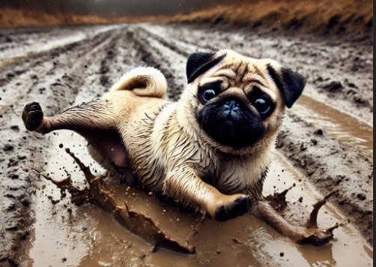
How I train my Pug
Presented by:
Guilherme Trentini

Slide 2
Concept recap
How I Train My Pug? is a fast-paced racing where players race their pug in dynamic, obstacle-filled environments. The goal is to guide your pug through a series of levels, mastering skills like dodging, and collecting power-ups to beat your opponents and become the champion of the pug racing.
Genre: Top-down racing game

Slide 3
Prototype Goals reached
Pug movement: Up, down, right and left
Background theme racing tracks: Park and Beach
Countdown to start the race and timer
Bark sound and counting
Barrels (3) and bones (5) spawning
Barrels exploding after a bark
Sound after pickup the bones

Slide 4

Lets check the code prototype

